Slide 1

Comparing the Experiential Learning Results for In-person versus Remote Internships
OEB 2021 - Rachael Criso
Notes:
Virtual Internships started in 2018 after recognizing that the future of work was at our doorstep, and more students across the world would need to prepare for remote work experience as well as create a network of virtual connections to succeed. Students can work in 18 different career fields with companies spanning over 70 different countries. Throughout the past 2 years, VI has supported over 1800 students in accessing remote internship experiences.

Slide 2

1
Remote Work Opportunities
In-Person vs Remote Internship Programming
Unpacking the Data and Analysis
Key Skills Gain Overview
Reviewing Common Hypotheses
2
3
4
5

Slide 3


Remote Work and Internship Trends
Notes:
JILLIAN

Slide 4
REMOTE WORK OPPORTUNITIES
Looking back: Early remote work - 1980s Wifi/Internet
Virtual Internships 2018
2020: Covid - Zoom - Work can go on
Benefits of remote work: flexibility, no commute (low carbon footprint), juggle family/work/study commitments & maximise available time
Can work be as productive? Lack of structure & water cooler culture & facetime.
Upskilling of online work: digital professionalism, self-reliance, autonomy, time management, potential new culture
“
Over 70% of respondents
replied that they are more or just as efficient when working from home. Only 1 in 4 think that their productivity might suffer when working outside the office.”
-Deloitte, How Covid-19 contributes to a long-term boost in remote working
“
Notes:
RACHAEL

Slide 5
THE FUTURE OF WORK & REMOTE INTERNSHIPS
Bridging gap between college/work.
Internships to virtual internships.
Need to provide accessible internship experience for all
Future of Work is now
Digital Fluency
Enhanced Employability
End goal - Meaningful Employment Post Graduation
Ultimate Question:
Can a remote Internship provide work experience that can match the upskilling that occurs in an in-person internship?
Notes:
RACHAEL

Slide 6

Remote & In-Person Internships
Notes:
JILLIAN

Slide 7
DEFINING INTERNSHIPS
For this report and Virtual Internships standards, all internships include the following features:
A minimum 120-hour position held within an established company or organization with a focus on professional exposure and development.
Project-based learning experiences that are academically aligned with clear projects and goals stated at the commencement.
Working in a position clearly designated as an “internship” by the host company or organization.
Direct supervisor engagement and interaction complemented by consistent opportunities for reflection and feedback.
When defining a remote internship, call it what you will: Remote Internship, Virtual Internship, Online Internship, Tele-working, Telecommuting, it all means the same thing: the participant will be completing their internship without a commute and directly from their current location.
Notes:
RACHAEL

Slide 8
In-Person Internships
All Internships
Remote Internships
Opportunities
Direct industry exposure
Increased transferable skills
Career exploration
Hard and soft skills gain
Workplace communication
Exposure to ambiguity that you cannot capture in a classroom
Structured project-based assignments
Exposure to digital tools such as Trello, Slack, Zoom, etc.
Increased accessibility
Attention to time management
Exploring Workplace Culture
Mix of day-to-day projects and larger projects
“Water Cooler” Networking and Conversations
Threats
Commute and access
Administrative work / “Coffee & Copies”
Increased health and safety considerations
Supervisor engagement
Unpacking skills gain
Lack of intern engagement
Understanding Workplace Culture
Increased initiative needed
Networking is structured & limited
Technical issues can halt work
Risk of Isolation
Mental health and wellbeing

Slide 9

The
Data
Notes:
JILLIAN

Slide 10


Program Similarities | Program Differences
Placement Guarantee Online Program Curriculum Project-Based Placements with Experienced Host Companies Career Fields Program Supports | Program Location Online Program Curriculum Individual Coaching Hours Worked Per Week

Slide 11








NACE CAREER READINESS COMPETENCIES
All Virtual Internship and CRCC Asia programming is grounded in the NACE competencies including:
Online Curriculum
Coaching Calls
Webinars / Workshops
Skills Assessment
Critical Thinking & Problem-solving | Oral & Written Communication | Teamwork & Collaboration | Digital Technology
Leadership | Professionalism & Work Ethic | Career Management | Global / Intercultural Fluency

Slide 12
REVIEWING THE DATA
To what extent do you exercise sound reasoning to analyze issues, make decisions, and overcome problems?
What would this look like?
When you encounter a problem, you investigate to determine the root cause because the problem may be a symptom of a deeper issue.
When you run into a problem at work, you first brainstorm a few ideas on your own before going to your supervisor.
When you're tasked with developing a plan, you gather relevant and reliable data through research and consider potential implications
Both programs incorporate a pre and post self-assessment.
Assessment includes a series of 3 questions per competency, with an average score for each calculated and reported.
Every question includes examples of what the skill would look like in the workplace to allow the student to accurately understand the competency.
Virtual Internship Likert Scale
Never | Little Extent | Some Extent | Moderate Extent | Above Average Extent | Great Extent | Always
1 | 2 | 3 | 4 | 5 | 6 | 7

Slide 13
ASSESSING THE DATA
Significant Loss (decreased by 2 scales or more)
Loss (decreased by less than 2 scales)
No Gain (no increase or decrease)
Gain (increased by less than 2 scales)
Significant Gain (increased by 2 scales or more)
Significant Loss
Loss
Significant Gain
Gain
Never | Little Extent | Some Extent | Moderate Extent | Above Average Extent | Great Extent | Always
1 | 2 | 3 | 4 | 5 | 6 | 7
% of Participants
noting a Gain
% of Participants
noting a Significant Gain
TOTAL% of Participants
Who noted gain in skills

Slide 14
REVIEWING THE DATA
CRCC Asia supported 1041 participants in 2019
Virtual Internships supported 1592 participants in 2020
Host Company Locations: To assist in removing location as a variable only internships occurring with a host company in Eastern Asia were compared.
Duration: Both CRCC Asia and Virtual Internships structure their program durations with participants choosing 4, 8, or 12 weeks. 70% of participants from both samples chose 8-weeks.
CRCC Asia Data: CRCC Asia had 145 students (14%) complete both the pre and post assessment, with 142 having completed their internship in Eastern Asia.
Virtual Internships: Virtual Internships had 538 students (34%) complete both the pre and post assessment, with 216 having completed their internship in Eastern Asia.

Slide 15
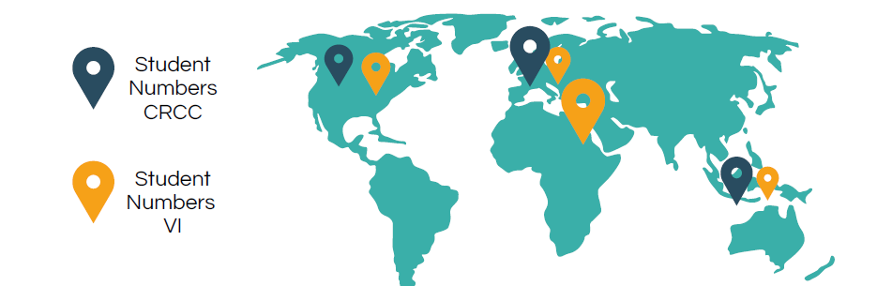
COUNTRY OF STUDY
 |  | CRCC Asia | Virtual Internships
 | AUSTRALASIA | 4% | 1%
 | EUROPE & UK | 75% | 8%
 | MIDDLE EAST & NORTH AFRICA | 0% | 79%
 | US & CANADA | 21% | 12%

Slide 16





CHOSEN CAREER FIELD
Student Numbers CRCC Asia | Student Numbers VI
Creative Industries and Communications
Includes Media, Comms,& Publishing, and Creative, Design, & Fashion, Urban Planning & Architecture
6% (8 participants)
12% (26 participants)
Engineer, Comp Science & Green Tech
Includes Engineering, Computer Science & IT, Green Technology & Sustainability
12% (17 participants)
22% (47 participants)
General Business
Includes Business, Finance, Entrepreneurship & Startup, Hospitality, Events, & Tourism, Marketing, Real Estate, Recruitment & HR
50% (71 participants)
56% (121 participants)
Healthcare
Includes Healthcare & Pharmaceuticals, Health, Wellness, & Sports Mgmt,
6% (9 participants)
3% (7 participants)
Legal and Int Dev
Includes Legal and International Dev, NGOs & Charities
26% (37 participants)
7% (15 participants)

Slide 17

Unpacking Skills Gain in Remote and In-Person Internships

Slide 18
Surprise!
Overall there were no significant differences in skills gain for in-person or virtual internships - While in-person internships showed slightly higher gains in critical thinking/problem solving and career management, there was no competency that experienced a difference in growth of more than 7%, with an average difference of 4% (favoring in-person internships).

Slide 19
OVERALL SKILLS GAIN
Remote
In-Person
Critical Thinking & Problem Solving
Oral/Written Communications
Teamwork / Collaboration
Digital Technology
Leadership
Professionalism / Work Ethic
Career Management
Global / Intercultural Fluency
67%
66%
72%
68%
65%
67%
66%
61%
64%
65%
68%
72%
63%
53%
68%
51%

Slide 20
CRITICAL THINKING & PROBLEM-SOLVING
Significant Loss (-2) | Loss | No Change | Gain | Significant Gain (+2)
Remote
In-Person
Total Gain: 68%
Total Gain: 71%
3%
14%
14%
51%
17%
14%
14%
54%
17%
Remote interns as they need to rely on themselves when it comes to day-to-day decision making, often needing to push ahead with a project without supervisor input.
In-person interns enhance critical thinking/problem solving skills by learning to adapt to a professional environment, figuring out how to navigate public transportation when they don't speak the language, and embracing the full-time commitment to navigate a new culture.

Slide 21
ORAL & WRITTEN COMMUNICATION
Significant Loss (-2) | Loss | No Change | Gain | Significant Gain (+2)
Remote
In-Person
Total Gain: 65%
Total Gain: 66%
2
16%
16%
43%
22%
15%
19%
42%
24%
Less face-to-face daily interactions make it crucial for remote interns to convey their meaning using alternative methods. The absence of daily (physical) conversations can also demand a more precise use of language in order to avoid misunderstandings.
Those interning in-person are navigating a work environment in English, but in an entirely different culture and country and this can impact a student’s comfort level with communication.

Slide 22
TEAMWORK & COLLABORATION
Significant Loss (-2) | Loss | No Change | Gain | Significant Gain (+2)
Remote
In-Person
Total Gain: 65%
Total Gain: 68%
2%
16%
18%
46%
19%
20%
12%
51%
17%
“
[....]my favorite was the close relationship I got to form with my supervisor and teammates. I am walking away from my internship with new personal and professional connections that will last for years to come. This experience has made me so much more confident in obtaining internship opportunities as
well as full-time positions in the future!
-Lauren Retzloff, Miami University of Ohio, Recruitment & HR Virtual Intern
This slightly higher gain may be attributable to the increased ease with which in-person work may occur as the physical proximity lends itself to more spontaneous collaborations.
The similar increases in skill gain between the two programs, helps to ease concerns that a remote internship does not allow for collaboration and integration.
“

Slide 23
DIGITAL TECHNOLOGIES
Significant Loss (-2) | Loss | No Change | Gain | Significant Gain (+2)
Remote
In-Person
Total Gain: 63%
Total Gain: 68%
2%
16%
19%
43%
20%
11%
21%
40%
28%
Remote interns saw their cyber skills improve less when compared to in-person interns (63% vs 68%).
All remote interns need to get up to speed with their remote communication platforms, their online chat forums, and perhaps also learn new software to be able to complete their work.

Slide 24
LEADERSHIP
Significant Loss (-2) | Loss | No Change | Gain | Significant Gain (+2)
Remote
In-Person
Total Gain: 66%
Total Gain: 67%
2%
16%
15%
40%
26%
21%
12%
44%
23%
We might assume that an intern working alone at their computer in their home or dorm room would have less of an opportunity to learn leadership skills than an intern who is physically on-site with their colleagues
Remote interns noted a similar gain as in-person interns. This is perhaps because some remote interns worked in groups and cohorts. Motivating peer student teams to work well together and produce high-quality work requires leadership

Slide 25
PROFESSIONALISM & WORK ETHIC
Significant Loss (-2) | Loss | No Change | Gain | Significant Gain (+2)
Remote
In-Person
Total Gain: 67%
Total Gain: 61%
16%
17%
55%
12%
21%
18%
42%
19%
Unlike working in an office, where a seat filled can often be assumed as work being completed, a remote intern needs to and focus on their work ethic and motivation in order to ensure focus and success
One of the most common pieces of advice for remote interns to give future participants is “concentrate on time-management and do not procrastinate.”

Slide 26
CAREER MANAGEMENT
Significant Loss (-2) | Loss | No Change | Gain | Significant Gain (+2)
Remote
In-Person
Total Gain: 65%
Total Gain: 72%
2%
21%
12%
43%
22%
12%
16%
39%
33%
Here we note the biggest skills impact in favor of in-person internships
This was despite similarities between the two experiences in terms of career fields, company types, and similar project-based tasks and assignments
This skills difference may be due to the very nature of in-person work, and how it is perceived as “real-world work” with students experiencing commutes, office culture, and watercooler interactions for the very first time
“
The internship has provided me with an invaluable international experience in consulting. I am confident that it will give me an
advantage over other applicants when looking for a new position.
Dorottya Fekete, Goldsmiths, University of London, Business intern in Beijing
“

Slide 27
GLOBAL / INTERCULTURAL FLUENCY
Significant Loss (-2) | Loss | No Change | Gain | Significant Gain (+2)
Remote
In-Person
Total Gain: 53%
Total Gain: 51%
4%
15%
27%
42%
11%
23%
26%
33%
18%
A higher percentage of remote interns believed they had improved their global and intercultural fluency skills
Both in-person and remote interns did have to work with host companies located in different countries, resulting in working across different communication styles, professional high-hierarchies, cultural contexts and more allowing for intercultural fluency to improve.

Slide 28

Common
Hypotheses Review
Notes:
JILLIAN

Slide 29
Remote
In-Person
53%
51%
INTERCULTURAL FLUENCY WILL HAVE A
GREATER IMPACT IN-PERSON
“Humbling Effect” for in-person participants, seeing 23% of participants noting a loss of competency
A professional working in another culture, maybe more focused on the other soft and hard skills gleaned from their day to day work, then the full cultural immersion and understanding gained.
International internships themselves may lend to a slightly less focus on intercultural fluency compared to traditional study abroad programs, as they are having to balance professional development with global preparedness.
Notes:
JILLIAN

Slide 30
Remote
In-Person
63%
68%
DIGITAL FLUENCY WILL BE THE TOP SKILL GAINED IN A REMOTE INTERNSHIP
The professional insight platform, Chesamel, recently published an article “Digital Skills for the Future of Work” that underscores the imperative of digital literacy for those entering the workforce and they note that currently, “82% of all job vacancies require digital skills.”
Remote interns may see their mastery of digital technology as ordinary and an “everyday skill” and may not understand the significance of their skills gain.
Supervisors may have pre-existing assumptions that a remote internship automatically leads to gains in digital technology. Therefore they do not focus as much with participants on enhancing these specific skills
Notes:
JILLIAN

Slide 31
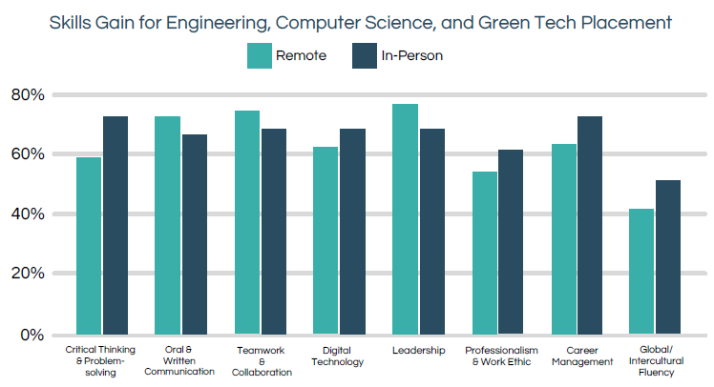
REMOTE INTERNSHIPS CAN ONLY WORK FOR
SPECIFIC TYPES OF INTERNSHIPS
Notes:
JILLIAN

Slide 32
COMPLETING AN INTERNSHIP
INCREASES CONFIDENCE IN POST-
GRADUATE EMPLOYMENT
After completing this internship, do you agree this experience increased your confidence in post-graduation employment?
75% In-person agreed | 88% Remote agreed
Notes:
JILLIAN

Slide 33

The Future of Work is Hybrid
Remote Internships are on the rise
Both In-Person and Remote Internships have shown little significant differences in skills gain
1
2
Starting the Debate on Remote versus In-Person Internship Skills Gain
January 2021
3

Slide 34


Virtualinternships.com
OEB: Booth G10
Questions?
Notes:
JILLIAN

